Slide 1

Creating the Finest Wine
Brett Bartol
Shreya Bhootda
Alex Cooper
Qingye (Vicky) Ding
Andre Han

Slide 2

Table of Contents
Data Summary
KNN / K-Folds
Trees
Linear Regression
Conclusion

Slide 3
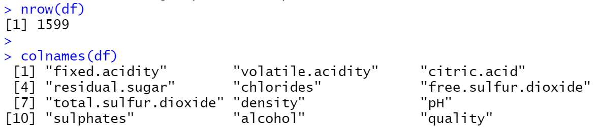
Data Summary

Slide 4
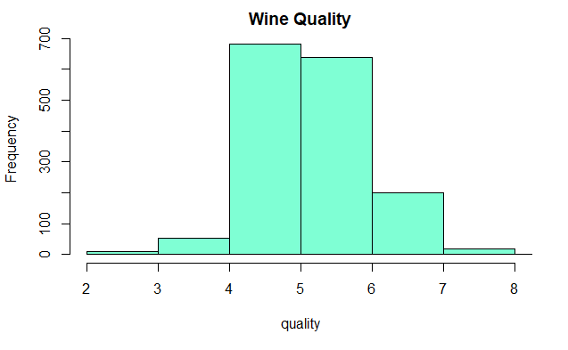
Distribution of Quality Scores

Slide 5
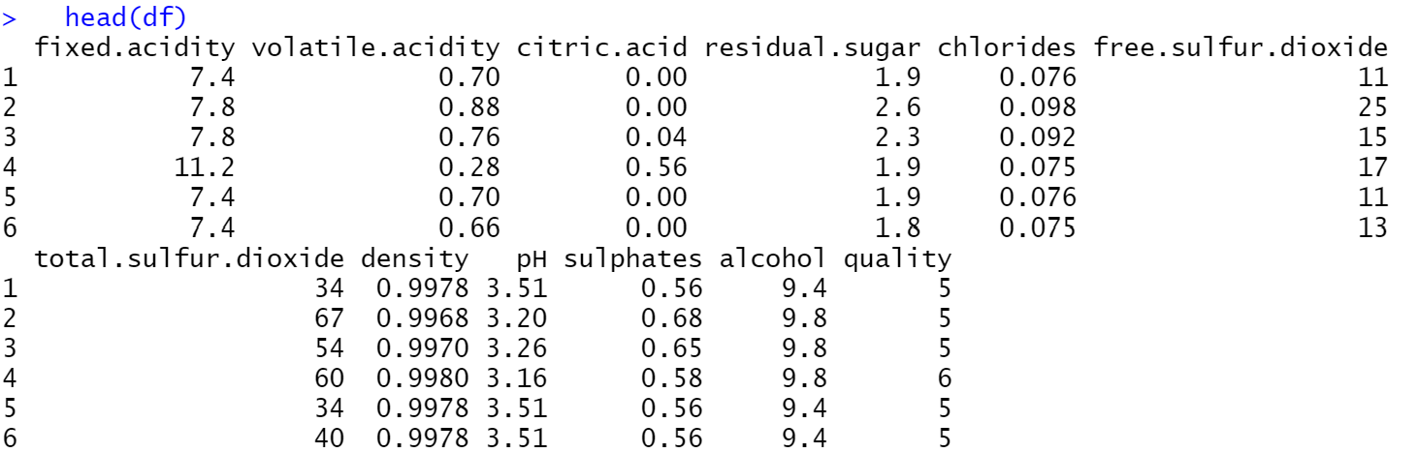
Data Summary

Slide 6
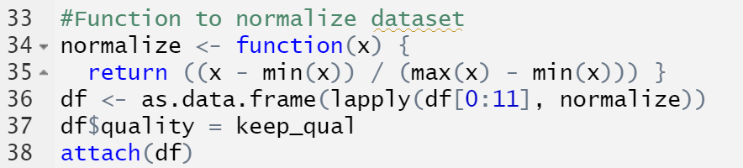
Normalizing Data

Slide 7
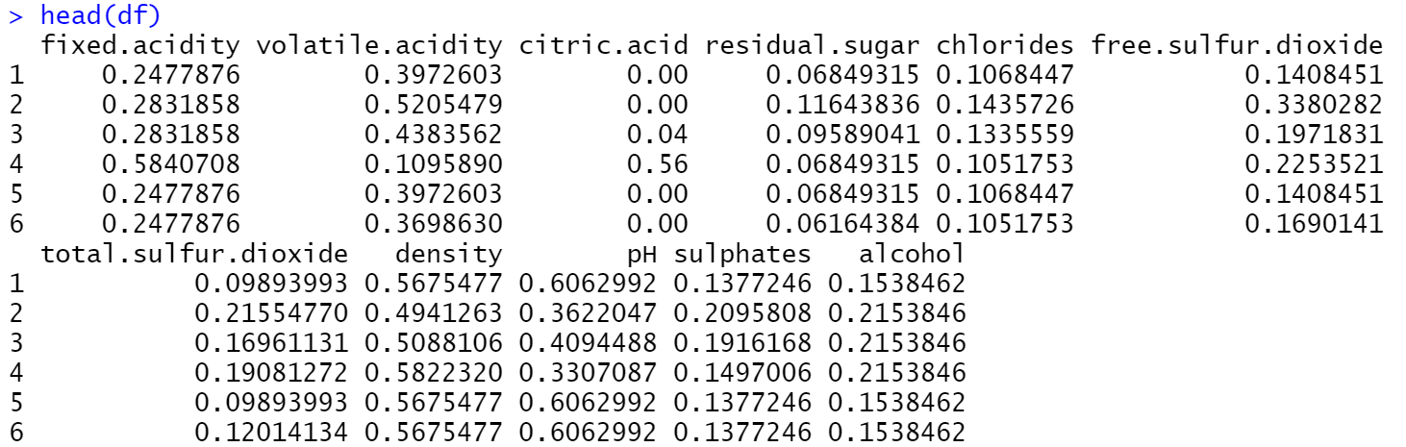
Normalizing Data

Slide 8
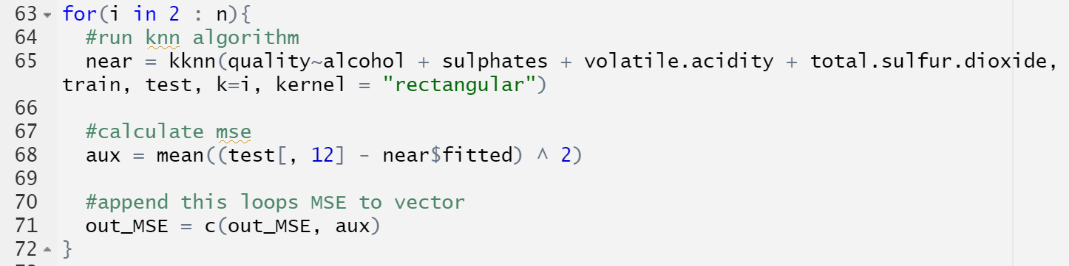
KNN

Slide 9
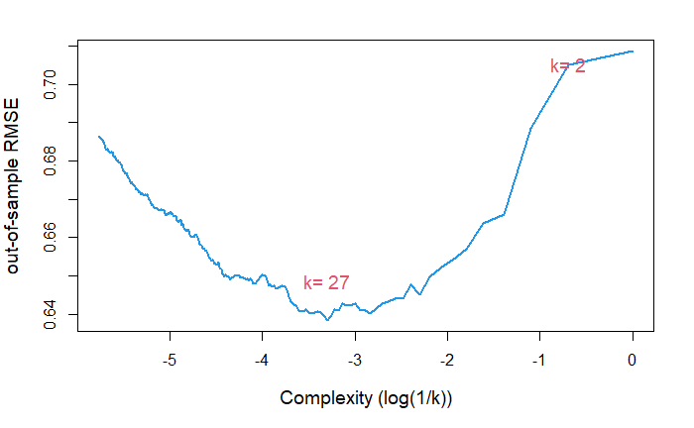
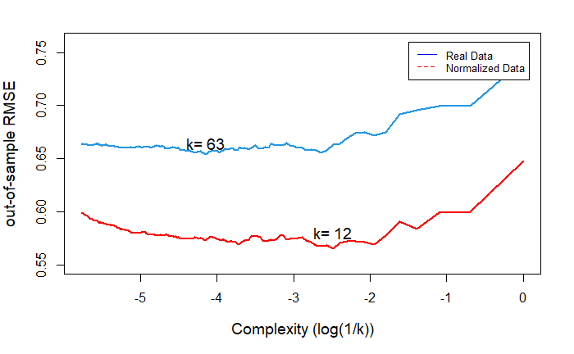
KNN

Slide 10
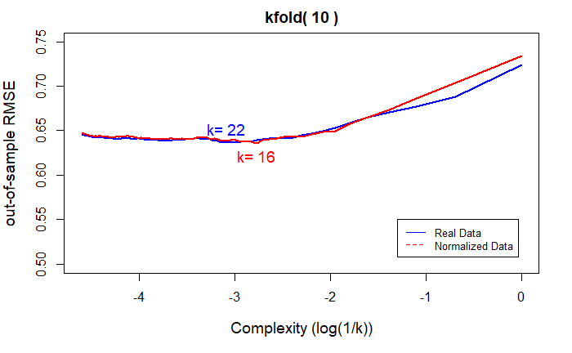
KNN: K-Fold

Slide 11
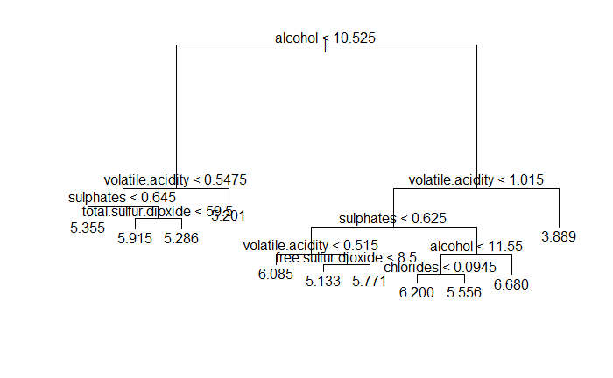
Regression Tree - Unpruned
Notes:
We also created various tree models, including regression tree, bagging, random forest, and boosting. Here is our regression tree, its built-in function automatically selected 6 features to split the tree, the selection also implies the importance of variables.

Slide 12
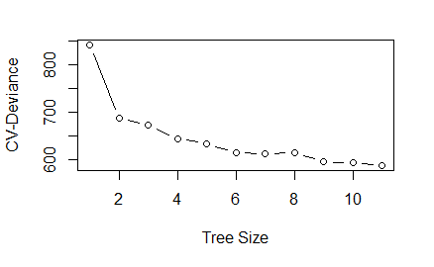
Performance: Regression Tree - Unpruned
Notes:
When tree size is between 6 to 10, the model has a relative low deviance.

Slide 13
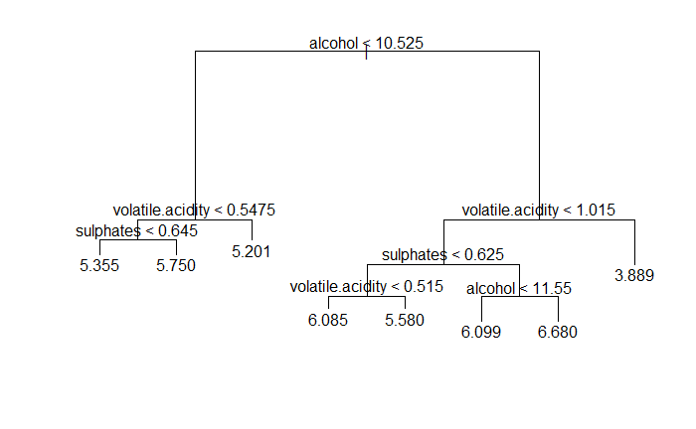
Regression Tree - Pruned
RMSE = 0.0333
Notes:
Therefore, we pruned the tree and set the number of leaves to 8.

Slide 14
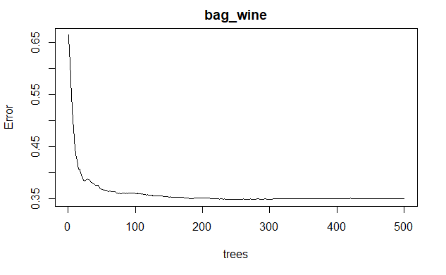
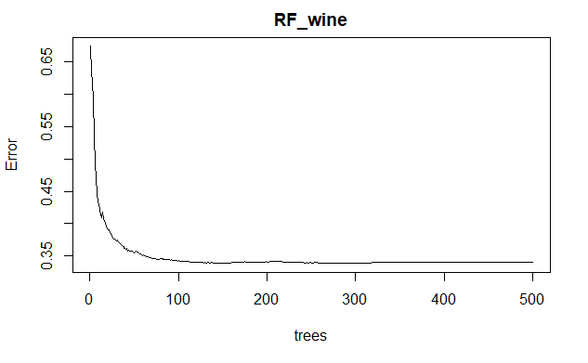
Bagging and Random Forest
Plot shows in-sample error
Out-of-sample RMSE: 0.5247

Slide 15
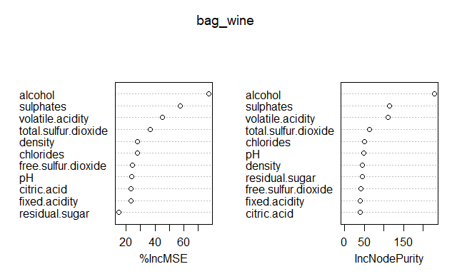
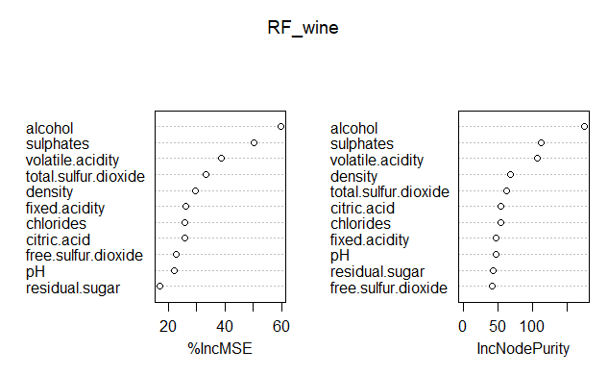
Predictor Importance

Slide 16
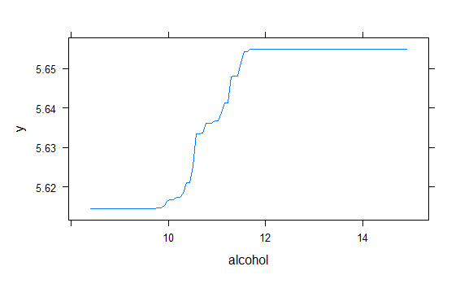
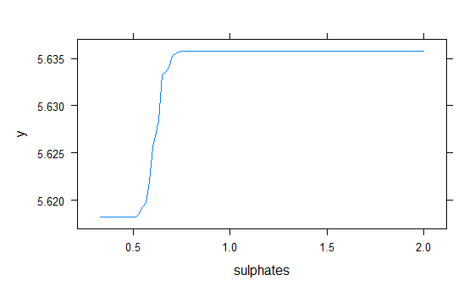
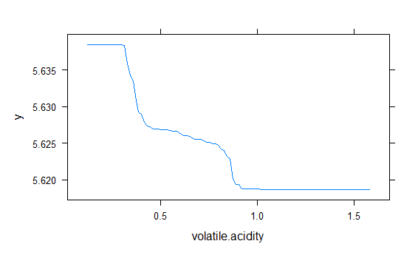
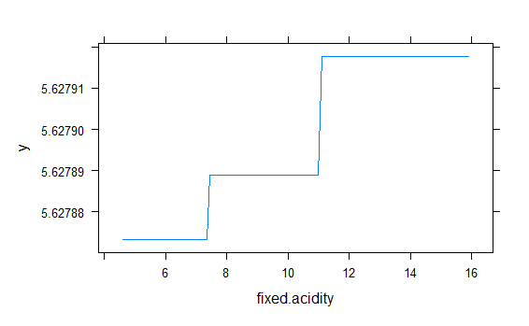
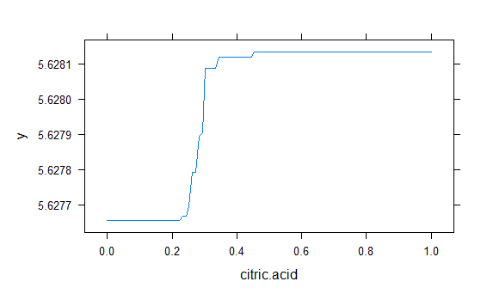
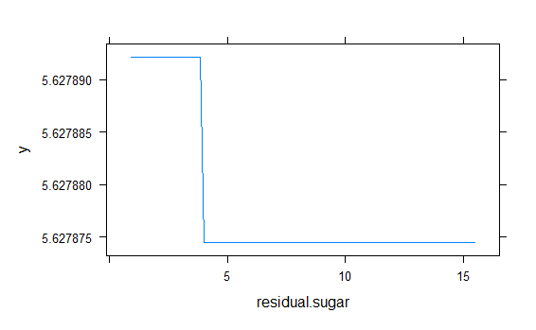
Boosting Tree - Marginal Effect of Variables

Slide 17
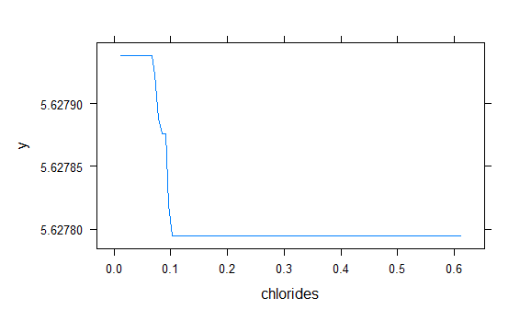
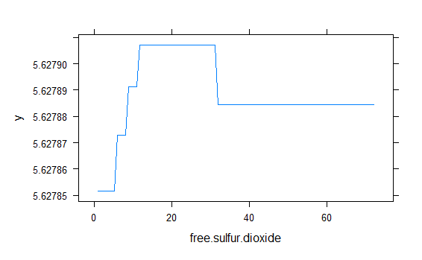
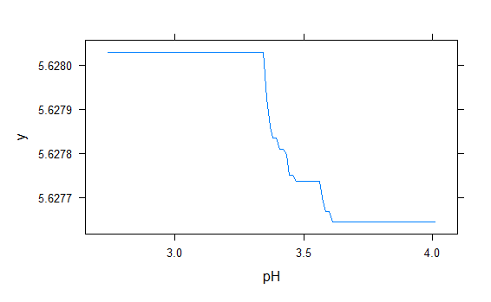
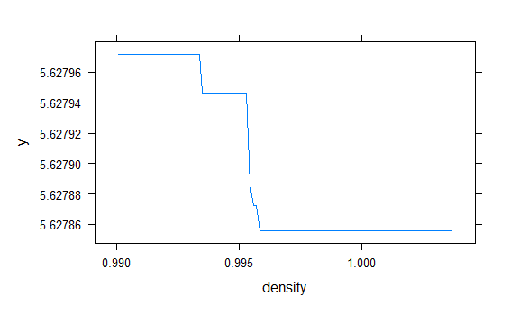
Boosting Tree - Marginal Effect of Variables

Slide 18
Performance Comparison of Tree Models
 | Pruned Tree | Bagging | Random Forest | Boosting_1 | Boosting_2
RMSE | 0.0333 | 0.5247 | 0.5212 | 0.0406 | 0.0198
No. of Predictors (m) | 3 | 11 | 4 for each split | 11 | 11
No. of Trees | 1 | 500 | 500 | 500 | 500
Tree Size (α) | 8
λ |  |  |  | 0.0001 | 0.1
Notes:
Boosting 1 is a simple model with a very small lamda

Slide 19
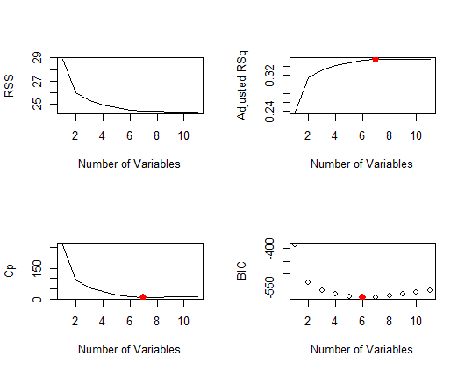
Regression - Model Selection
Notes:
By performing regression on the training set, we can see that the optimal model size according to Cp. AdjRSq and BIC is between 6 and 8. To select the optimal model we take a validation set approach and divide our data into test and training set.

Slide 20
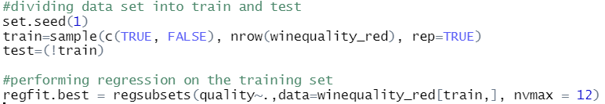
Regression - Model Selection
Notes:
We divided the data set into train and test and then performed

Slide 21
Regression - Final model
> val.errors
[1] 0.01954110 0.01776008 0.01733362 0.01771517 0.01771364 0.01734712 0.01726874 0.01731096 0.01730263
[10] 0.01729947 0.01728424 NA
> coef(regfit.best, 7)
(Intercept) volatile.acidity chlorides free.sulfur.dioxide total.sulfur.dioxide pH
0.52585860 -0.21469585 -0.22598576 0.08118032 -0.20907271 -0.10843714
sulphates alcohol
0.27851787 0.38686834
Notes:
After calculating the RMSE for different variable sizes we find out that model size of 7 is best suited for the data set. This result is inline with our adjR^2 plot.
Alcohol has the largest coefficients and therefore has the most effect on quality of wine.

Slide 22
Conclusion
Model | RMSE | Number of Predictors | Additional Information
KNN | 0.575 | 4 | k = 12
KNN (K-fold) | 0.645 | 4 | k = 16
Pruned Tree | 0.0333 | 3 | α = 8
Boosting | 0.0198 | 11 | Trees = 500 λ = 0.1
Regression | 0.0173 | 7
Notes:
In conclusion, we tested a wide variety of different models on our dataset and got significantly varying results. This chart summarizes some of the algorithms we developed, metrics used to developed them, and they’re results. None of the different variations of KNN models performed very well on this dataset, but we had a lot of success hypertuning different tree models. The regression model had the lowest RMSE of 0.0173 with an optimal number of predictors of 7. Across all models, the variables that had the biggest impact on our models were consistently a combination of alcohol, volatile acidity, sulphates, and sulfur dioxide. It is also important to note that some of these RMSE values varied with different seed values, especially the pruned tree.

Slide 23
Questions?

